Slide 1
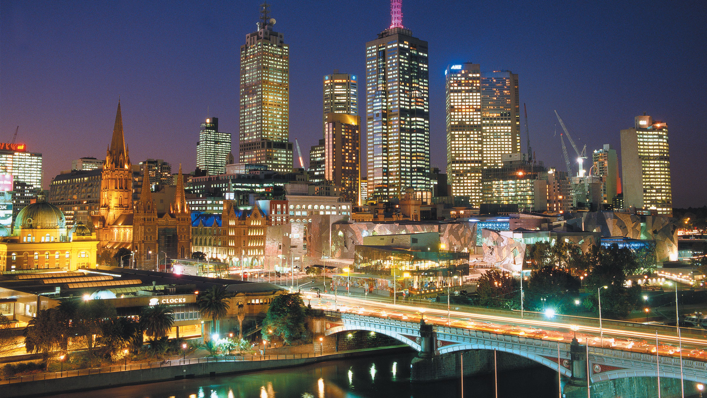

Crime in Victoria
Latest CRIME STATISTICS

Slide 2

Our project team members:
Antoinette Boyle,
Jacqueline Xia,
Kelvin Hung Nguyen,
Anh Huong
"Victorian crime statistics" over the last 10 years :
large data set, numerous tables, over 300k rows
interrogated this data using excel and python in Jupyter Notebook
repository on Github with branches
4 key questions:
Top offence types and trends
Top crime by region and concentration
Whether there is a correlation between number of police stations and crimes/offence status?
Is there a concentration of police stations, by regions?

Slide 3
Agenda
1.Introduction & Objectives (Antoinette)
2.Criminal Incidents & Recorded Offences (Antoinette)
3.Victim Reports & Family Incidents (Jacqueline)
4.Crime status & Police Service Areas (Kelvin)
5.Victoria Crimes Trends from September 2012 to 2021 (Anh)

Slide 4
Key Terminology
CRIMINAL INCIDENTS
Over the LAST Ten Years

Slide 5
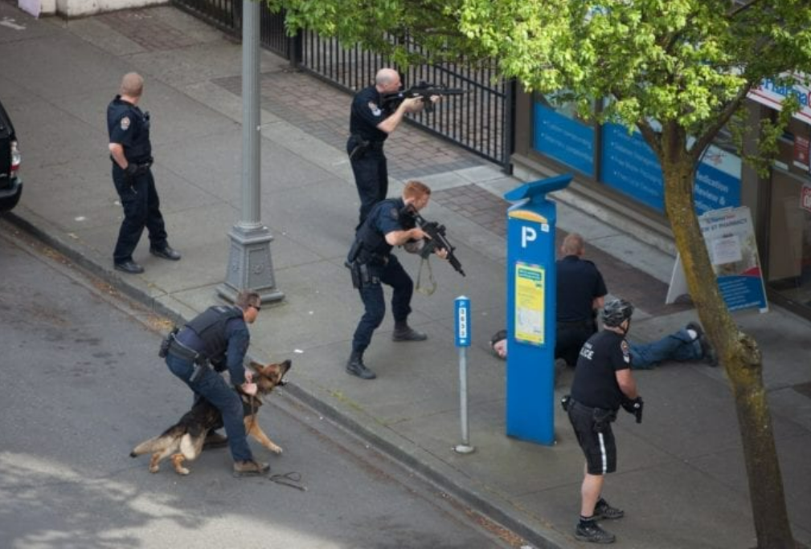
Key Terminology
Offence
Any reported criminal act or omission by a person or organisation for which a penalty could be imposed by the Victorian legal system.
Criminal incidents
A recorded criminal incident is a criminal event that may include one or more offences, alleged offenders and/or victims, and that is recorded on a single date and at one location. There's could be many offences in one criminal incident.
Alleged offenders
An alleged offender incident is an incident involving one or more offences to which an individual, business or organisation has been linked as an alleged offender.

Slide 6
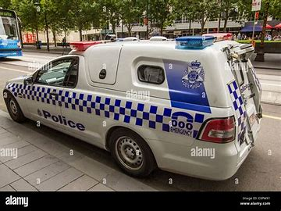
Key Terminology
Police Region
A Police Region is a geographical area defined by Victoria Police for operational purposes. There are 4 regions across Victoria each containing a number of Police Service Areas.
Local Government Area (LGA)
LGA’s are also referred to as municipalities, the 79 Victorian LGAs are classified as cities (34), shires (38), rural cities (6) and boroughs (1).
Victims
A victim report is counted when an individual, business or organisation reports to Victoria Police that they have been a victim of one or more criminal offences.
Family incidents
An 'affected family member' is the individual who is deemed to be affected by events occurring during the family incident. Where an affected family member has been in a family incident with more than one other party, they will be counted for each involvement.

Slide 7
Analysis of Offences
CRIMINAL INCIDENTS
Over the LAST Ten Years

Slide 8
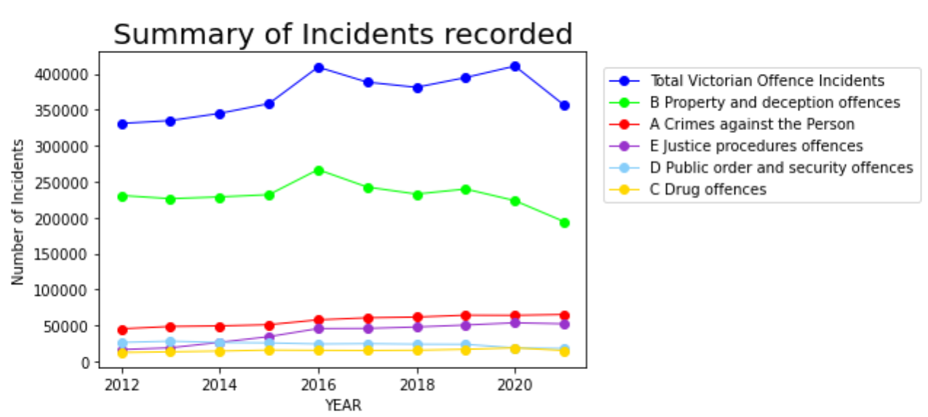
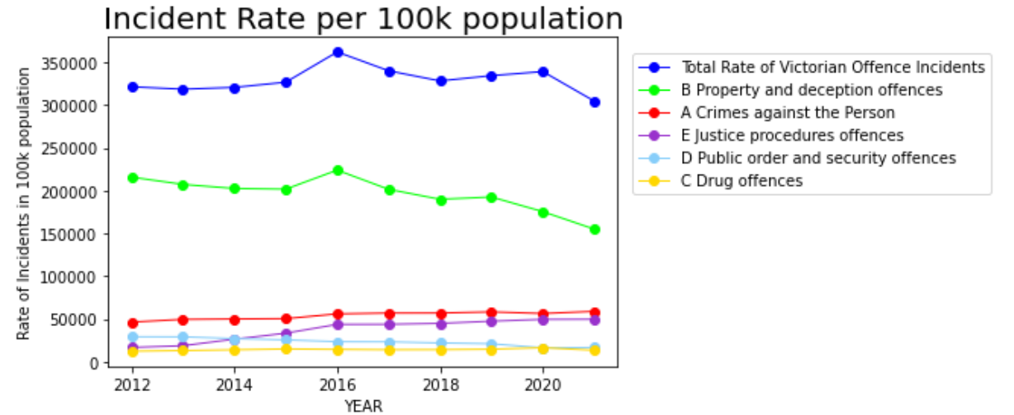
Note:
Property and deception offences (Green line) have far exceeded other Victorian offences followed by A Crimes against the person.
The peak in 2016 relates to “Theft” as we will explore in the next slide.
A significant drop in overall Crime from 2020 is mostly due to COVID lockdowns in Victoria. The rate per 100k population shows similar trends.

Slide 9
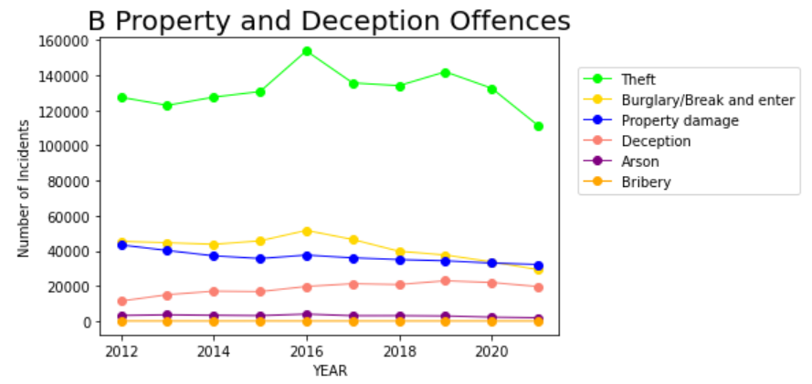
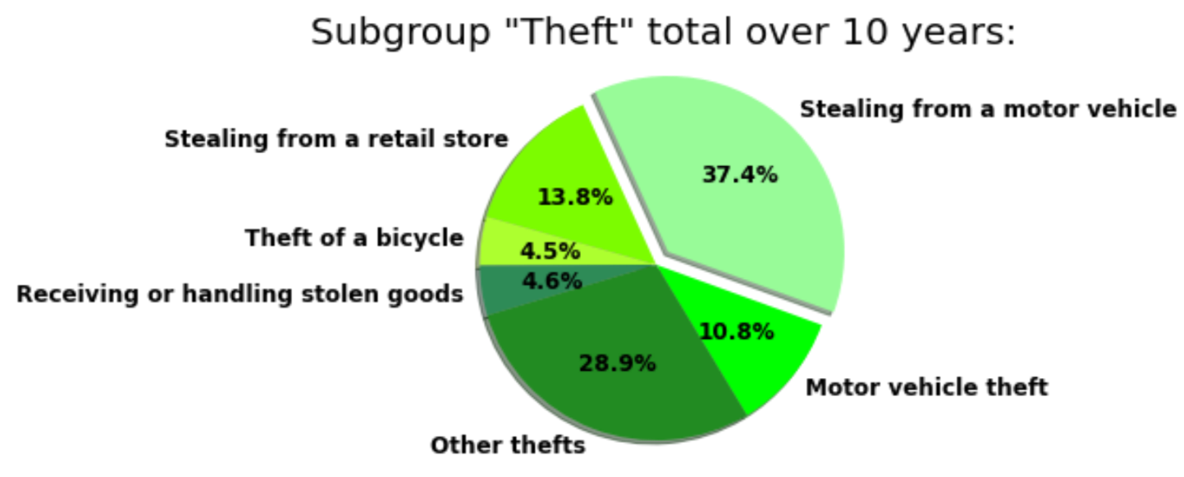
Note:
The peak in 2016 is mostly caused by “Theft”. The Moomba festival crime spree (Mar 2015) and the Bourke Road attack (Jan 2016) were both around this time.
The Covid lockdowns in 2020-2021 resulted in significantly less thefts but other crimes remained relatively stable.

Slide 10
And other more serious Offences?
CRIMINAL INCIDENTS
Over the LAST Ten Years

Slide 11
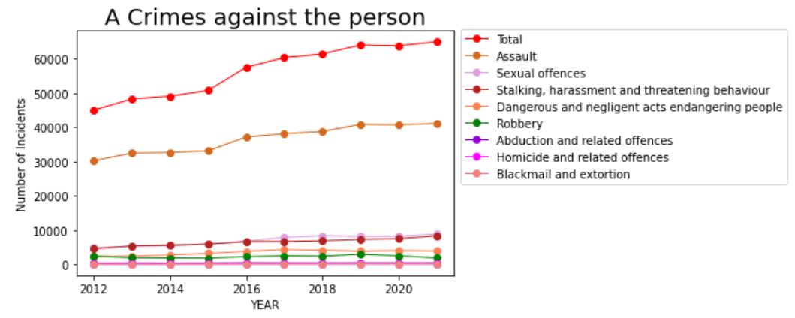
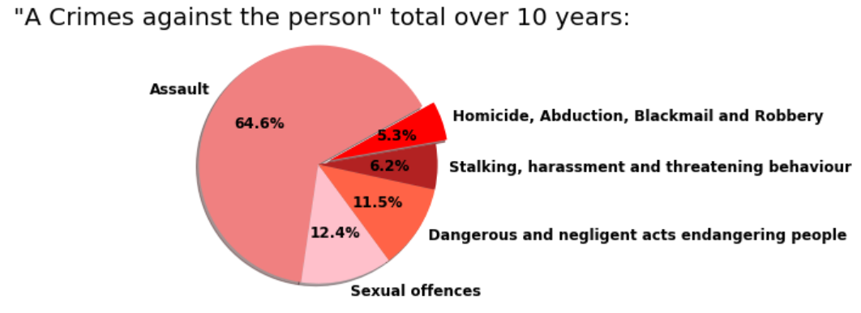
Note:
Assault is the most common crime in in this category 64%!
Assault has increased each year despite Covid 19 lockdowns.

Slide 12
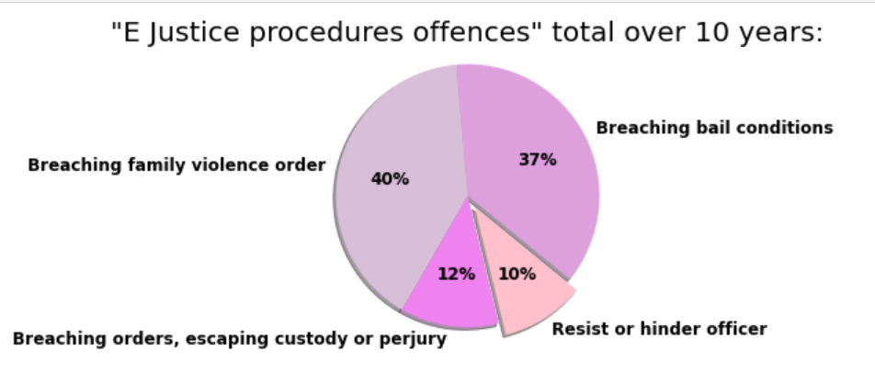
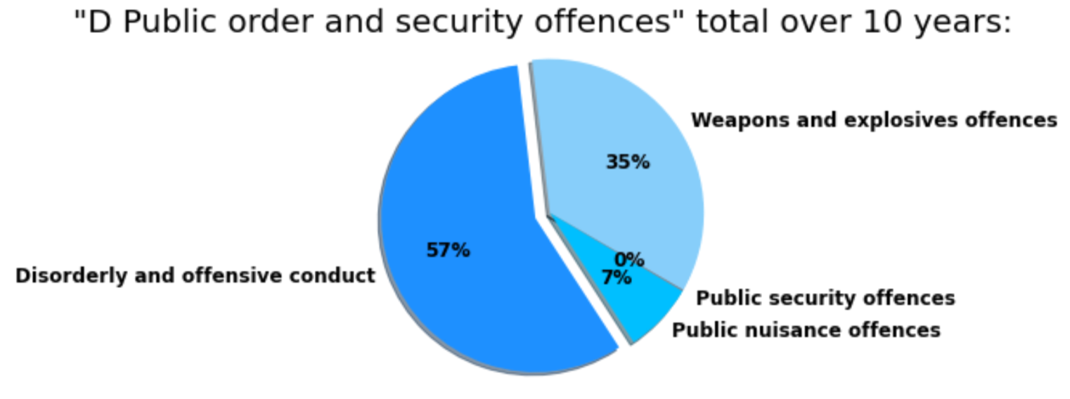
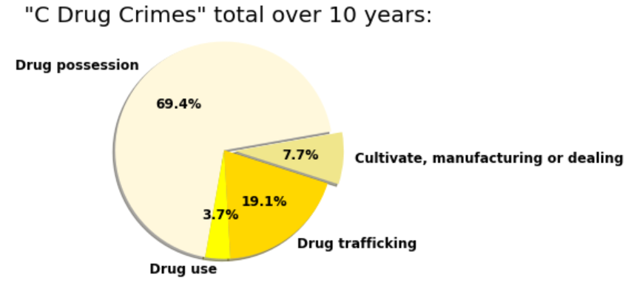
Note:
Other crimes are dominated by breaching Family violence orders(40%). Jacqueline will explore this issue in more depth.
Disorderly and offensive conduct(57%) and Drug possession(69%) are relatively high.
Weapons and explosive offences are noteworthy at 35%.

Slide 13
Region of Offences
CRIMINAL INCIDENTS
Over the LAST Ten Years

Slide 14
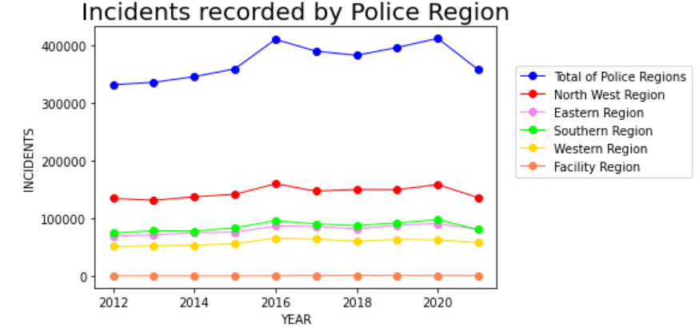
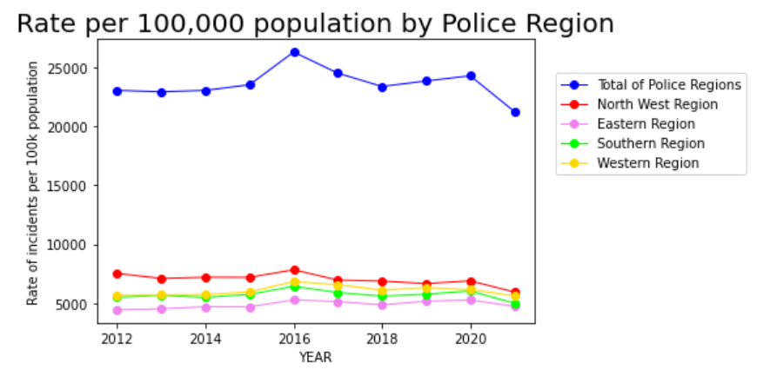
Note:
The Victoria Police Region breakdown shows most crimes are occurring in the North West Region
Rate per 100k population confirms trend.
In the following slide we will investigate the LGA‘s of the North West Region.

Slide 15
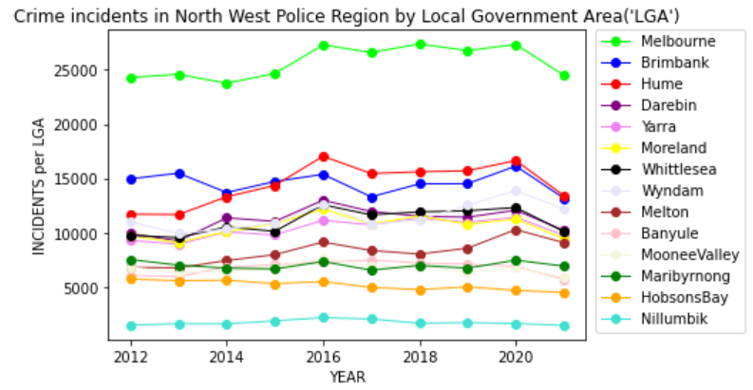
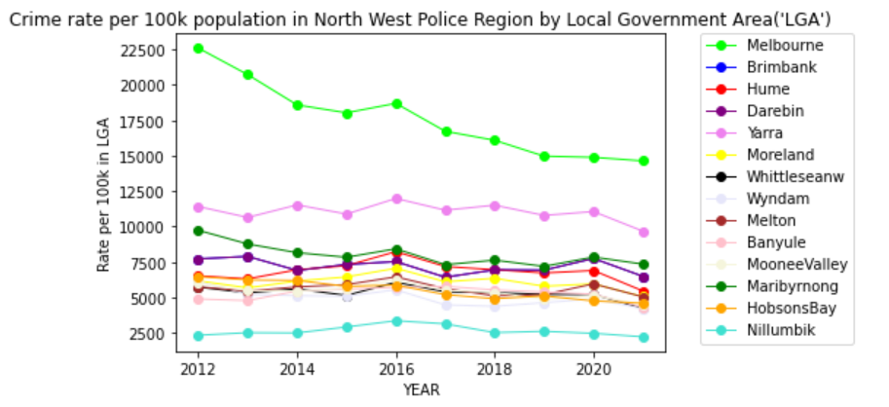
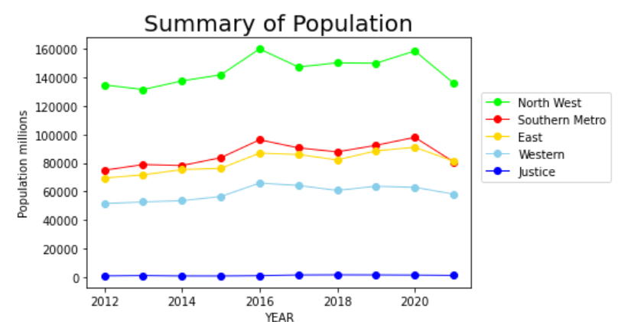
Note:
In North West Police Region, most crimes are occurring in Melbourne LGA (depicted by Green line).
The rate per 100,000 population shows a decrease in crime for Melbourne LGA since 2012.
This decrease is a combination of increased policing and higher population density in the city.
Yarra LGA has a relatively higher crime rate per 100k population.

Slide 16
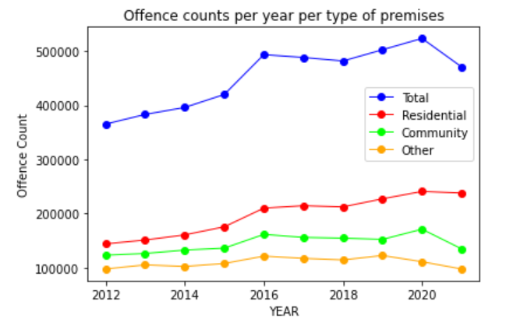
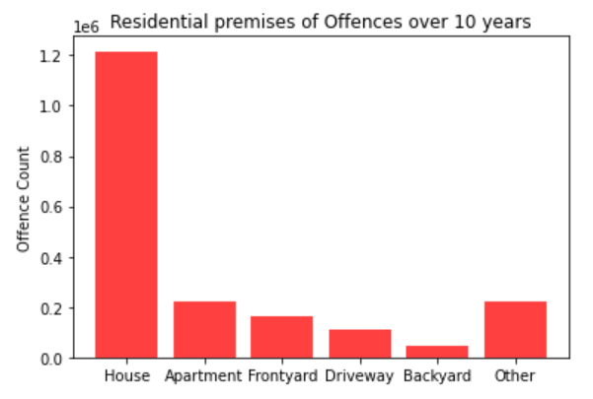
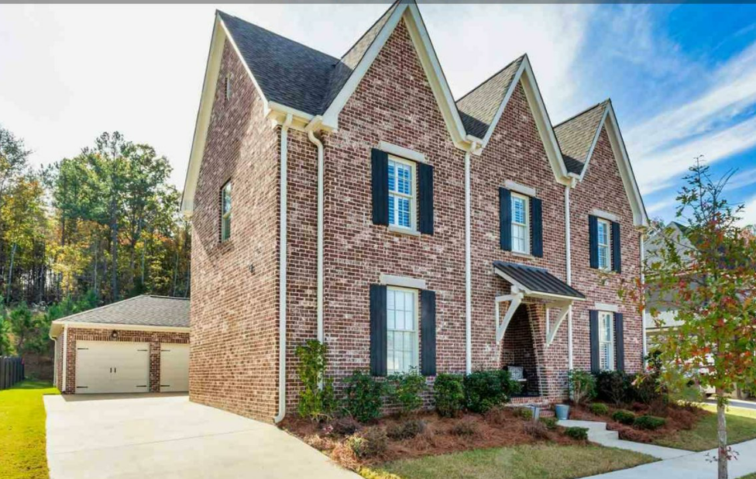
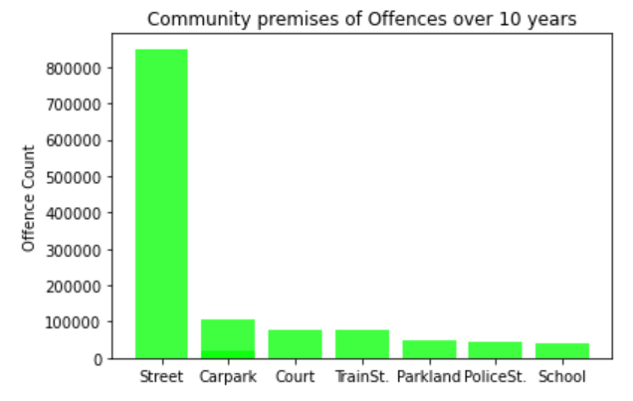

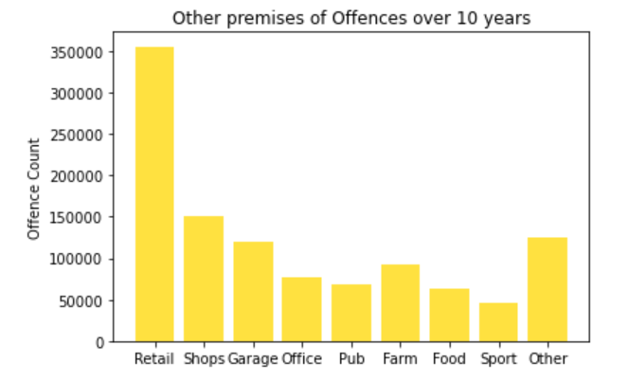
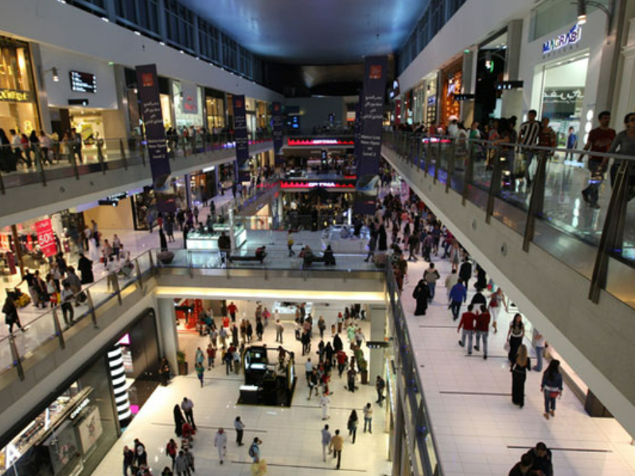
Note:
Most Residential crimes are happening inside Homes.
Streets are where most of the community crimes are occurring.
Crimes in other locations are mostly in the Retail setting

Slide 17
Agenda
1.Introduction & Objectives (Antoinette)
2.Criminal Incidents & Recorded Offences (Antoinette)
3.Victim Reports & Family Incidents (Jacqueline)
4.Crime status & Police Service Areas (Kelvin)
5.Victoria Crimes Trends from September 2012 to 2021 (Anh)

Slide 18
Victim Reports & Family Incidents
From September 2012 to September 2021

Slide 19
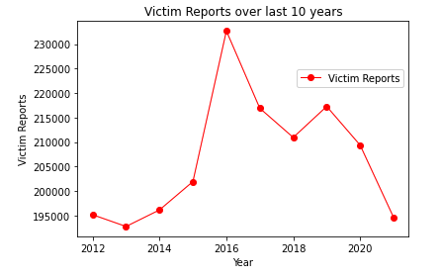
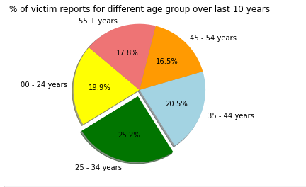
Trend of Victim Reports

Slide 20
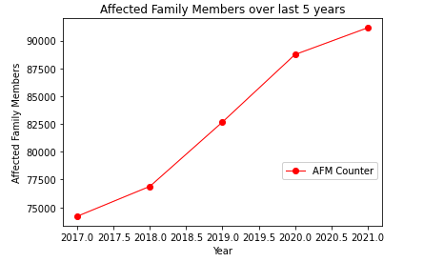
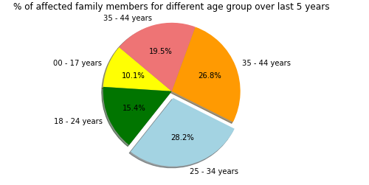
Trend of Affected Family Members

Slide 21
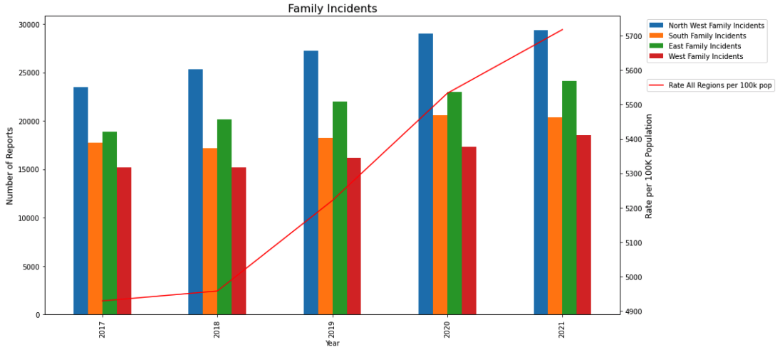
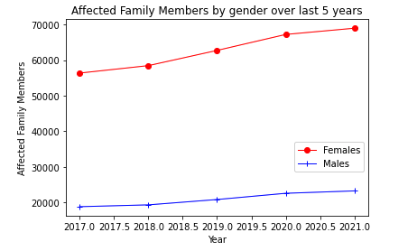
Trend of Affected Family Members

Slide 22
Agenda
Introduction & Objectives
Criminal Incidents, Recorded Offences (Antoinette)
Victim Reports & Family Incidents (Jacqueline)
Crime status & Police Service Areas (Kelvin)
Victoria Crimes Trends from September 2012 to 2021 (Anh)

Slide 23
How are police coping with criminal incidents?
CRIMINAL INCIDENTS
Over the LAST Ten Years

Slide 24
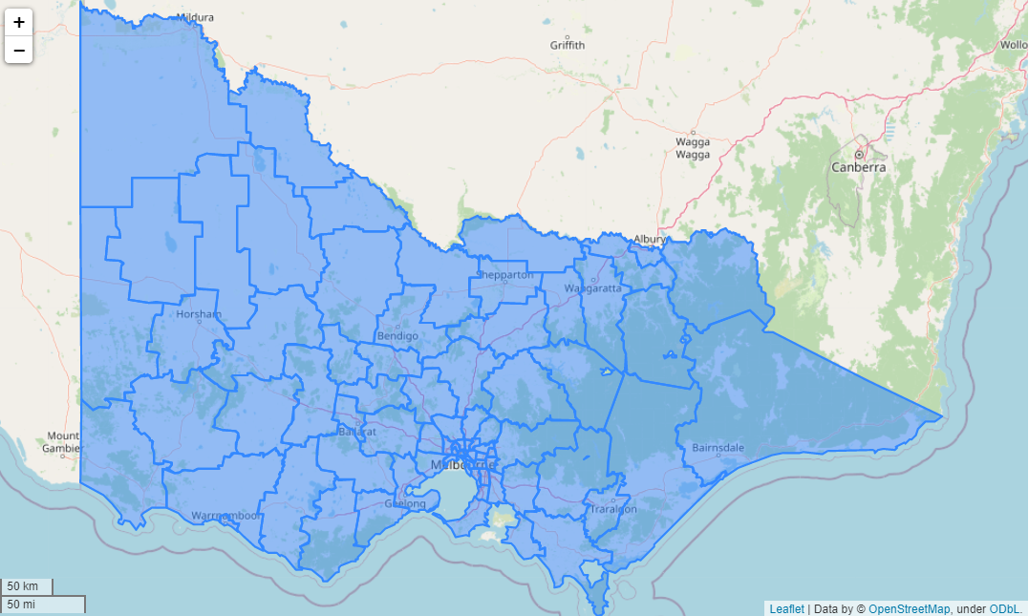
Local government areas (LGAs)
The 79 Victorian LGAs: are classified as cities (34), shires (38), rural cities (6) and boroughs (1).

Slide 25
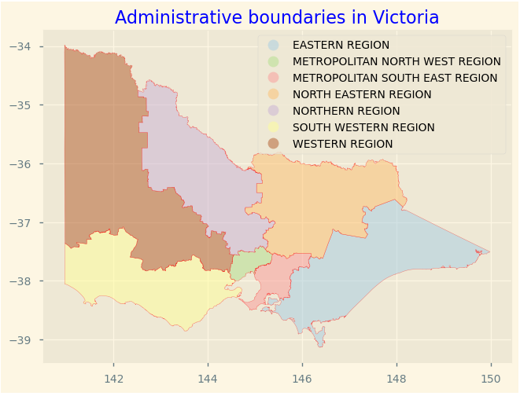
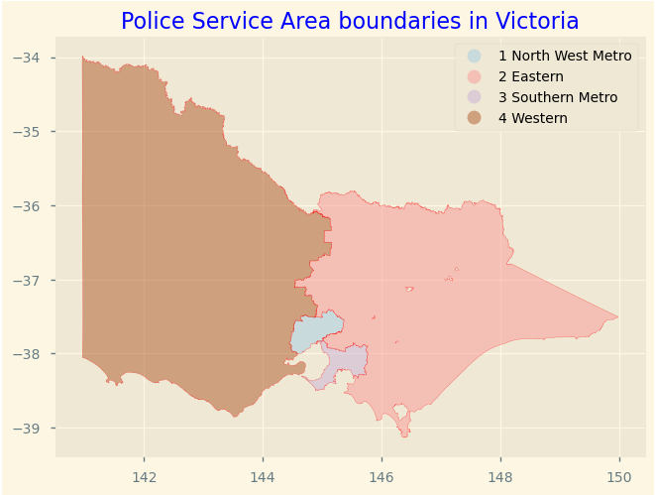
Where are Police Service Areas?

Slide 26
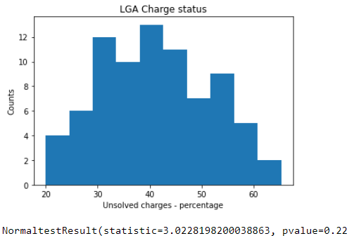
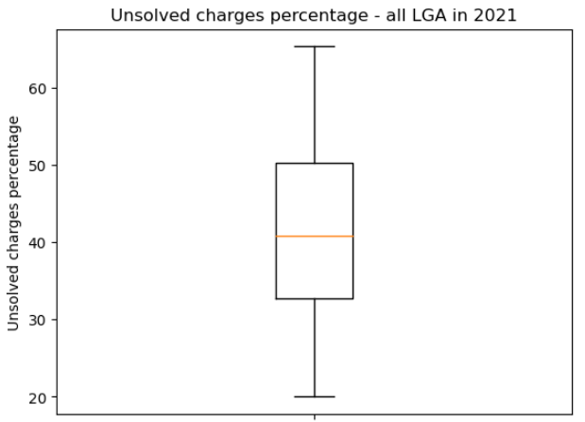
Data is normally distributed, no outliners identified
Unsolved charge percentage - 2021

Slide 27
Solved charge percentage - 2021
Mean unsolved: 41.5%
Median unsolved: 40.8%
Standard deviation: 10.4%
68% of LGA has unsolved charge percentage between 31.1% and 51.9% 95% of LGA has unsolved charge percentage between 20.7% and 62.3% 99.7% of LGA has unsolved charge percentage between 10.3% and 72.7%

Slide 28
Top vs bottom 5 LGA in 2021
Ranking | Local Government Area | Incidents Recorded | Total Incidents | Unsolved Status Percentage
1 | Swan Hill | 362 | 1810 | 20.00
2 | Southern Grampians | 172 | 780 | 22.05
3 | Ararat | 259 | 1134 | 22.84
4 | Wangaratta | 395 | 1631 | 24.22
5 | Northern Grampians | 233 | 879 | 26.51
... | ... | ... | ... | ...
75 | Bayside | 2007 | 3435 | 58.43
76 | Glen Eira | 3276 | 5440 | 60.22
77 | Maribyrnong | 4180 | 6903 | 60.55
78 | Boroondara | 3473 | 5535 | 62.75
79 | Queenscliffe | 47 | 72 | 65.28

Slide 29
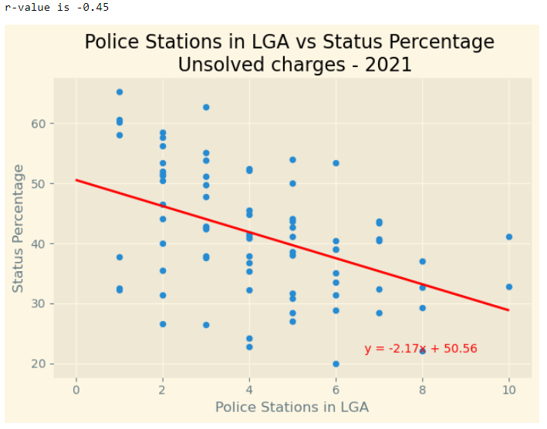

More police stations in each LGA, the lower the unsolved charge percentage
Standard error r² is 20.25%

Slide 30
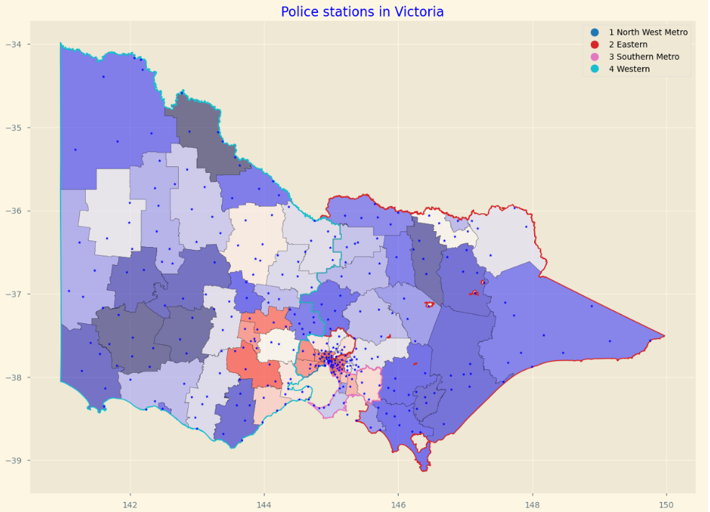
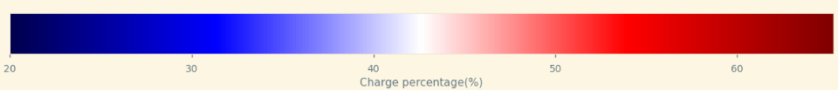

Slide 31
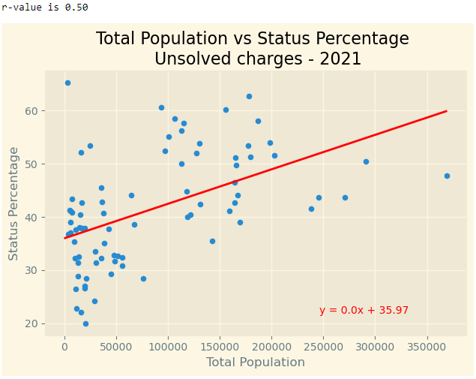

As the population increases in a LGA, the higher the percentage of unsolved charges
Standard error r² is 25%

Slide 32
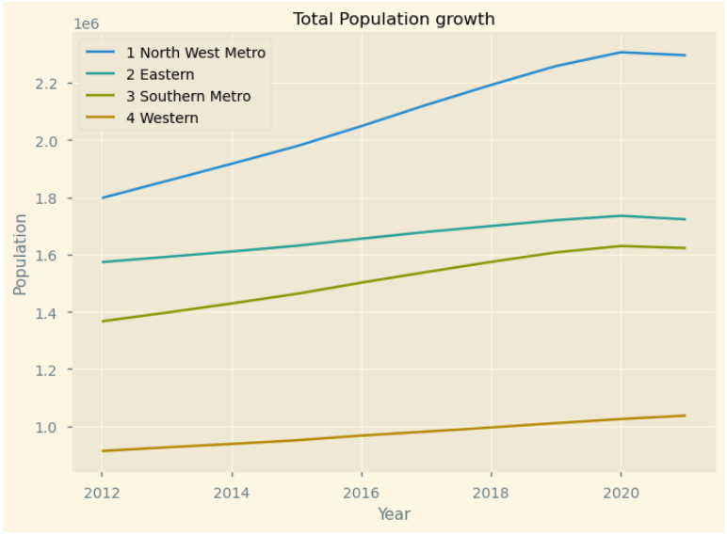
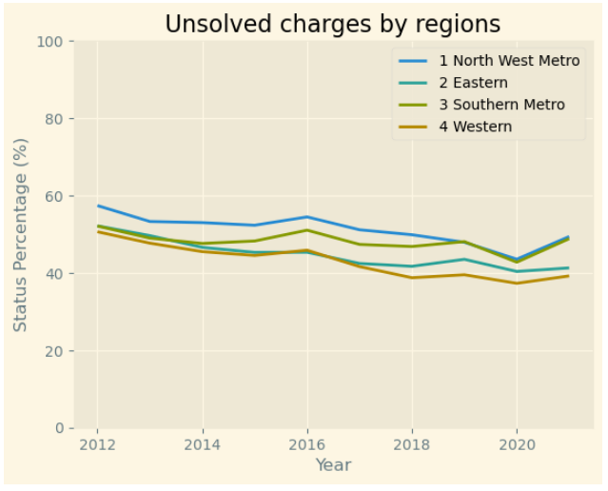


Time series analysis over 10 years

Slide 33
Agenda
Introduction & Objectives
Criminal Incidents, Recorded Offences (Antoinette)
Victim Reports & Family Incidents (Jacqueline)
Crime status & Police Service Areas (Kelvin)
Victoria Crimes Trends from September 2012 to 2021 (Anh)

Slide 34
Agenda
Introduction & Objectives
Criminal Incidents, Recorded Offences (Antoinette)
Victim Reports & Family Incidents (Jacqueline)
Crime status & Police Service Areas (Kelvin)
Victoria Crimes Trends from September 2012 to 2021 (Anh)

Slide 35
Overview Victoria Crimes & Family Incidents
From September 2012 to September 2021

Slide 36
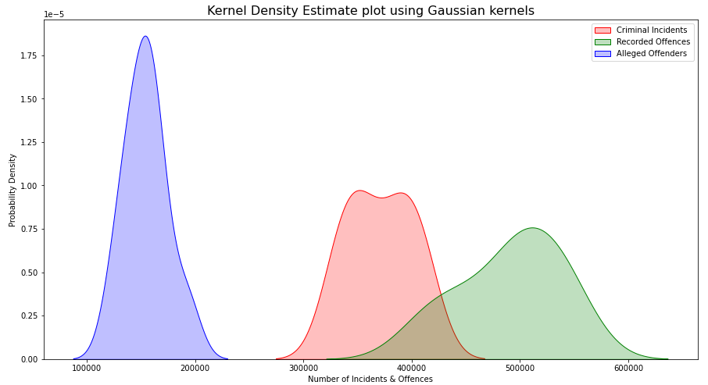
Criminal Incidents, Recorded Offences and Alleged Offenders
Kernel Density Estimation (KDE)
In statistics, Kernel Density Estimation (KDE) is a non-parametric way to estimate the Probability Density Function (PDF) of a random variable.
The graphs uses Gaussian kernels with automatic bandwidth determination based on “scotts_factor” formula: n**(-1./(d+4))

Slide 37
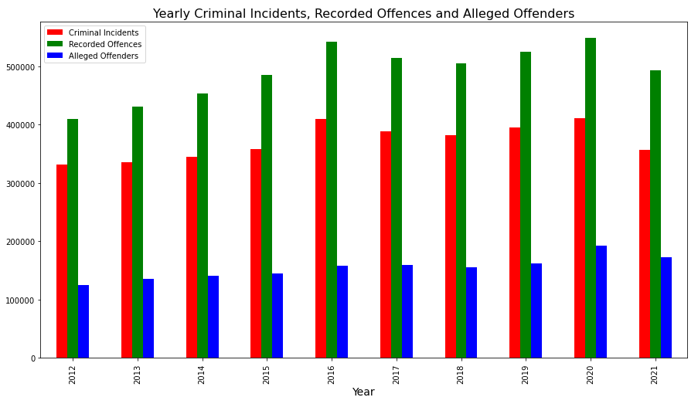
Criminal Incidents, Recorded Offences and Alleged Offenders
Yearly Percentage Changes
Year | Criminal Incidents | Recorded Offences | Alleged Offenders | Population
2012 | (Baseline) | (Baseline) | (Baseline) | (Baseline)
2013 | 0.012099 | 0.054790 | 0.090524 | 0.017587
2014 | 0.029842 | 0.052259 | 0.040208 | 0.024388
2015 | 0.039363 | 0.068144 | 0.028308 | 0.018456
2016 | 0.141908 | 0.116527 | 0.084495 | 0.021263
2017 | -0.051259 | -0.050605 | 0.008406 | 0.018048
2018 | -0.018528 | -0.018061 | -0.020907 | 0.029002
2019 | 0.035609 | 0.040722 | 0.043626 | 0.015371
2020 | 0.040523 | 0.044216 | 0.189915 | 0.021673
2021 | -0.131986 | -0.100593 | -0.105169 | -0.007842

Slide 38
Criminal Incidents, Recorded Offences and Alleged Offenders
Ten Years Overview Statistics
 | Criminal Incidents | Criminal Incidents Rate | Recorded Offences | Recorded Offences Rate | Alleged Offenders | Alleged Offenders Rate | Total
count (number of years) | 10.0 | 10.0 | 10.0 | 10.0 | 10.0 | 10.0 | 10.0
mean | 371,030.6 | 23,614.45 | 490,620.5 | 31,240.43 | 154,560.7 | 9,955.12 | 1,016,211.8
standard deviation | 29,772.09 | 1,304.28 | 46,454.24 | 1,856.8 | 19,499.59 | 713.94 | 92,297.04
min | 330,923.0 | 21,248.43 | 408,983.0 | 28,472.58 | 124,409.0 | 8,828.47 | 864,315.0
1st Quartile - 25% | 347,828.75 | 23,052.66 | 461,668.25 | 29,749.42 | 142,124.75 | 9,619.61 | 952,109.25
2nd Quartile - 50% (median) | 369,846.0 | 23,453.34 | 498,991.0 | 31,448.79 | 156,385.5 | 9,827.37 | 1,031,891.5
3rd Quartile - 75% | 393,172.5 | 24,177.39 | 522,423.75 | 32,315.31 | 161,301.75 | 10,256.3 | 1,076,898.0
max | 410,764.0 | 26,304.42 | 548,465.0 | 34,796.25 | 192,965.0 | 11,485.34 | 1,152,194.0
Observation:
Year 2016 has the highest Crime Incidents (26,304 incidents) and Recorded Offences (34,796 offences) rate per 100,000 population.
Year 2021 has lowest Crime Incidents (21,248.43) rate per 100,000 population.

Slide 39
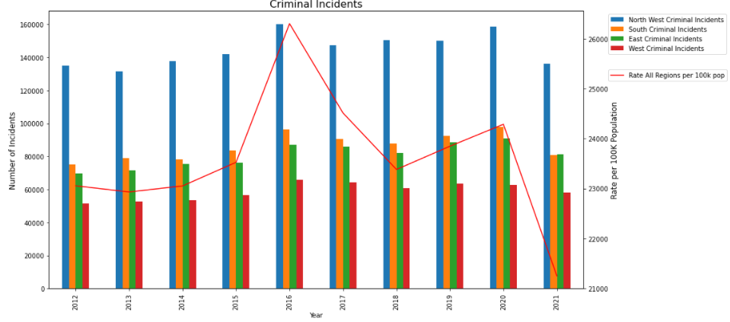
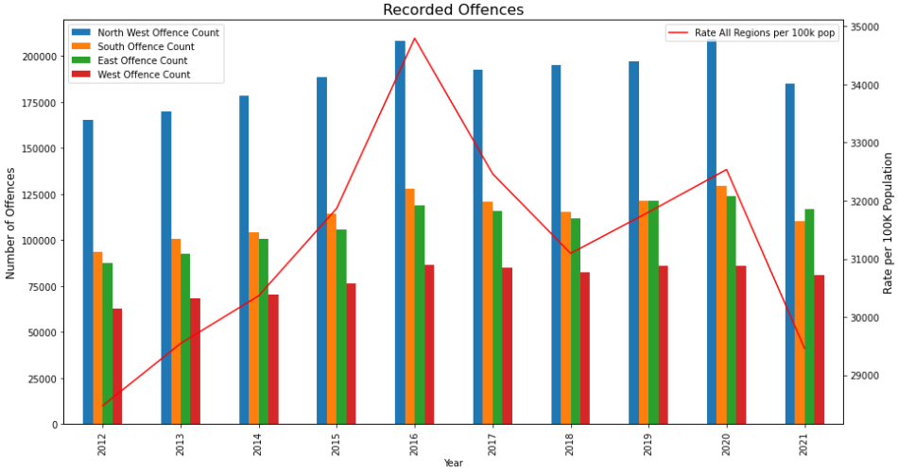
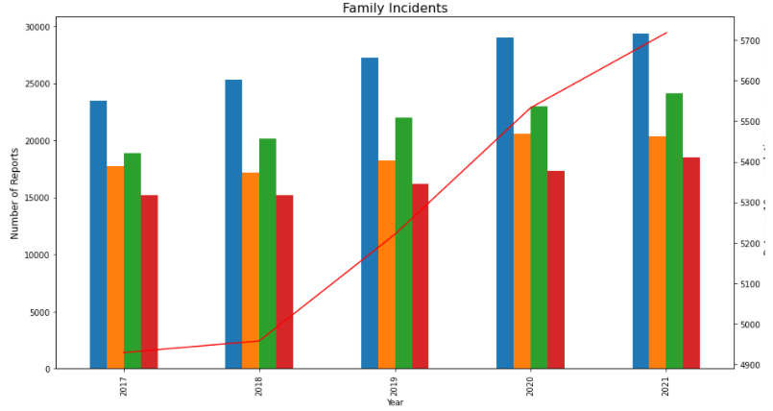
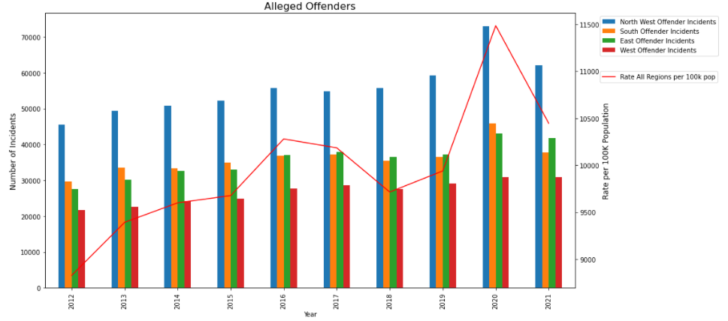
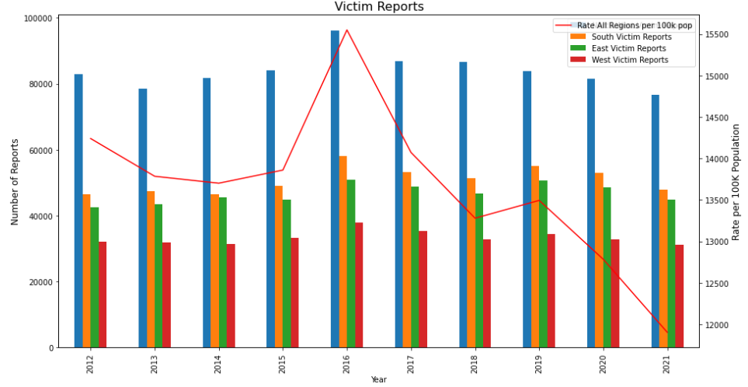
Victoria Crimes Trends by Police Service Region

Slide 40
Yearly Crimes Trends by Police Service Region
Percentage Changes of Number of Incidents and Offences by Police Region
Types | Police Service Region | Highest In Year | Highest Yearly Percentage Change
Criminal Incidents | Southern Metro | 2013, 2015, 2020 | Ÿ0.05, Ÿ0.07, Ÿ0.06
 | East | 2014, 2017, 2019 | Ÿ0.05, ”-0.01, Ÿ0.08
Recorded Offence | West | 2013, 2016, 2017, 2021 | Ÿ0.09, Ÿ0.13, ”-0.02, ”-0.06
Alleged Offender Incidents | Southern Metro | 2013, 2015, 2020 | Ÿ0.13, Ÿ0.42, Ÿ0.26
Victim Reports | East | 2013, 2014, 2017, 2019 | Ÿ0.02, Ÿ0.05, ”-0.04, Ÿ0.08
Family Incidents | North West Metro | 2018 | Ÿ0.08
 | East | 2019 | Ÿ0.09
 | Southern Metro | 2020 | Ÿ0.13
 | West | 2021 | Ÿ0.07
Observation:
Year 2019, East region is taking the lead in increasing in Crime Incidents (Ÿ0.06), Victim Reports (Ÿ0.08) and Family Incidents (Ÿ0.09) compares to other Police Service regions.
Year 2020, Southern Metropolitan region is having the highest increase in the Crime Incidents (Ÿ0.06), Alleged Offender Incidents (Ÿ0.26) and Family Incidents (Ÿ0.13) compares to other Police Service regions.

Slide 41
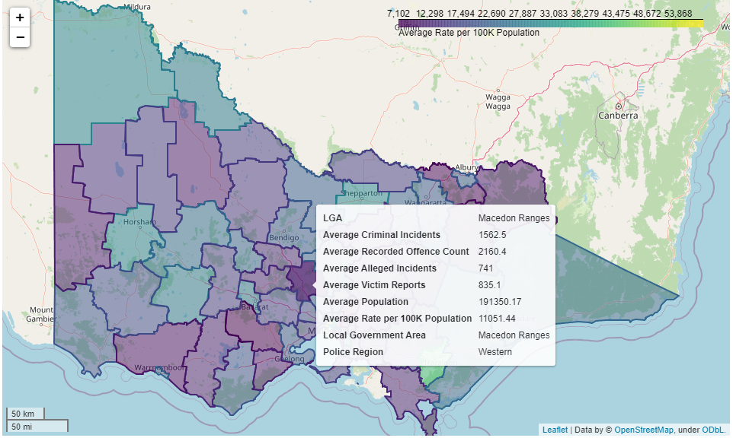
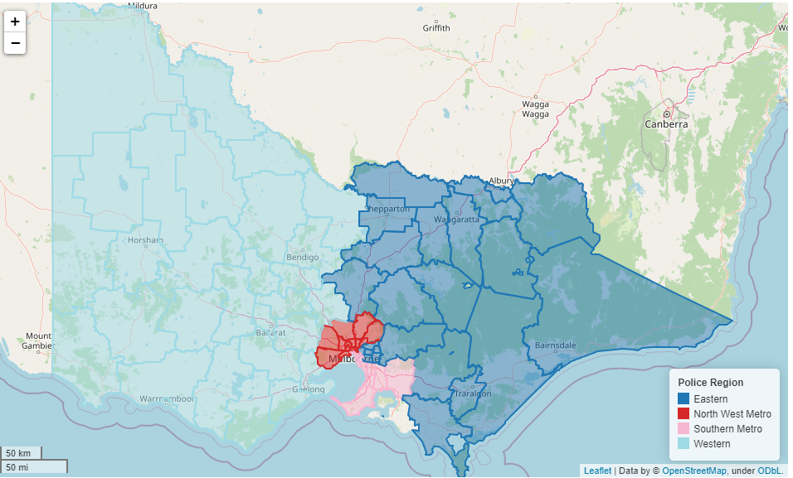
Victoria Crimes Data Maps
Average 10 years data of Criminal Incidents, Recorded Offence Count, Alleged Incidents & Victim Reports
Display By Local Government Area
Display By Police Service Region

Slide 42

Q&A

